Slide 1
Certificación AWS Developer Associate
Powered By

Slide 2
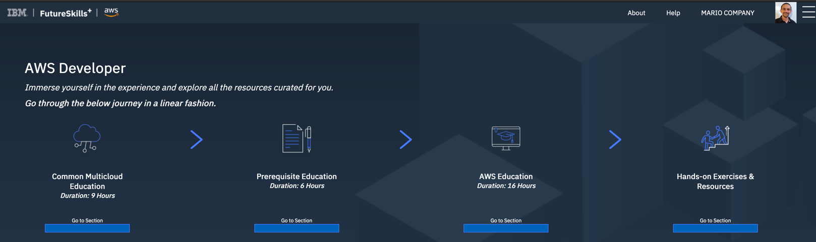

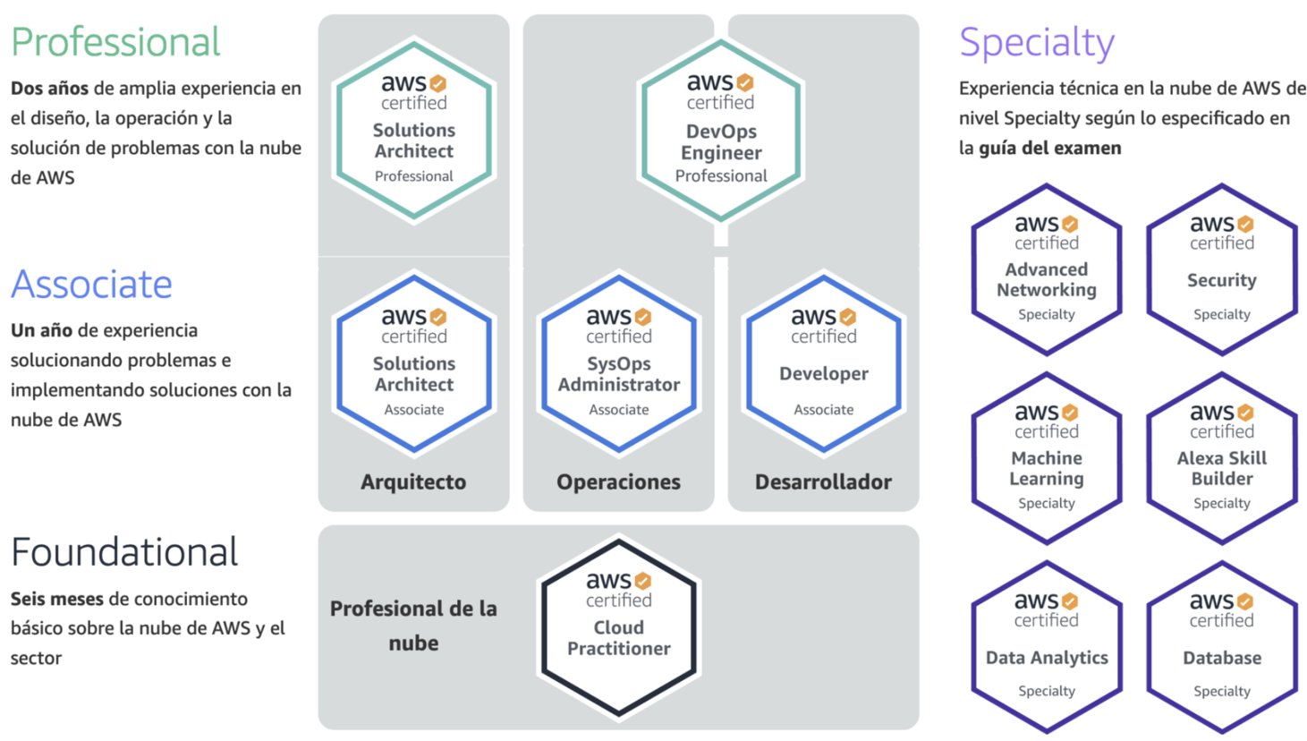
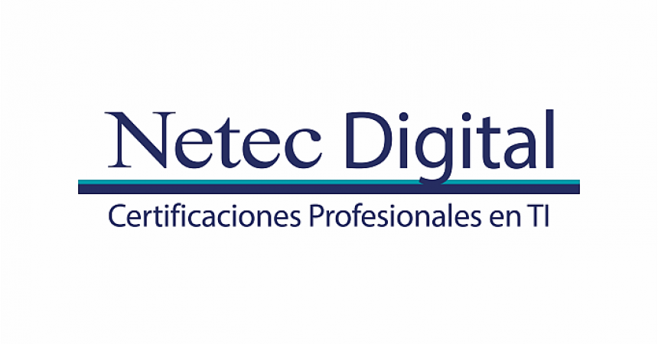
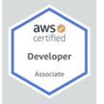
Path to AWS Developer Associate Certification
Roadmap & Work
A
B
http://lksprod.dst.ibm.com/collection/goto?id=179
https://aws.amazon.com/es/certification/
C

Slide 3
Path to AWS Developer Associate Certification
Netec => 1 semana
Udemy Course => No más de 1 mes
Exámenes Udemy => 15 días

Slide 4
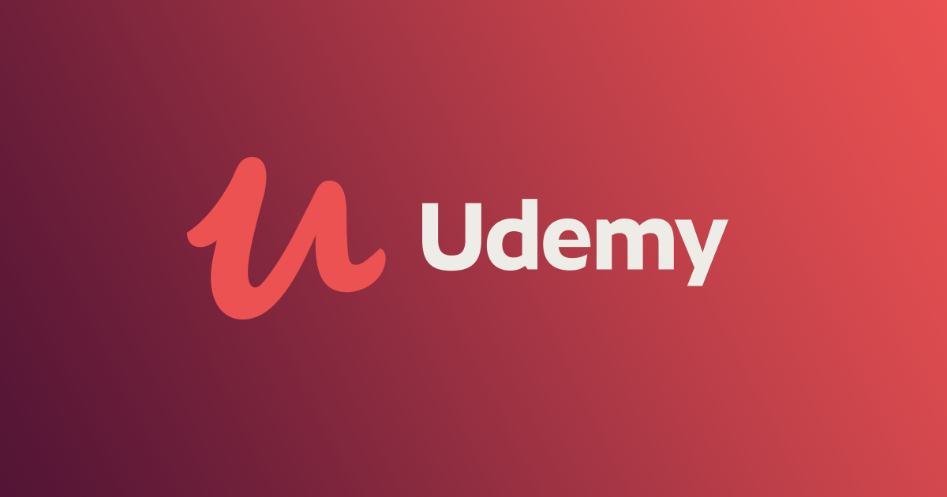
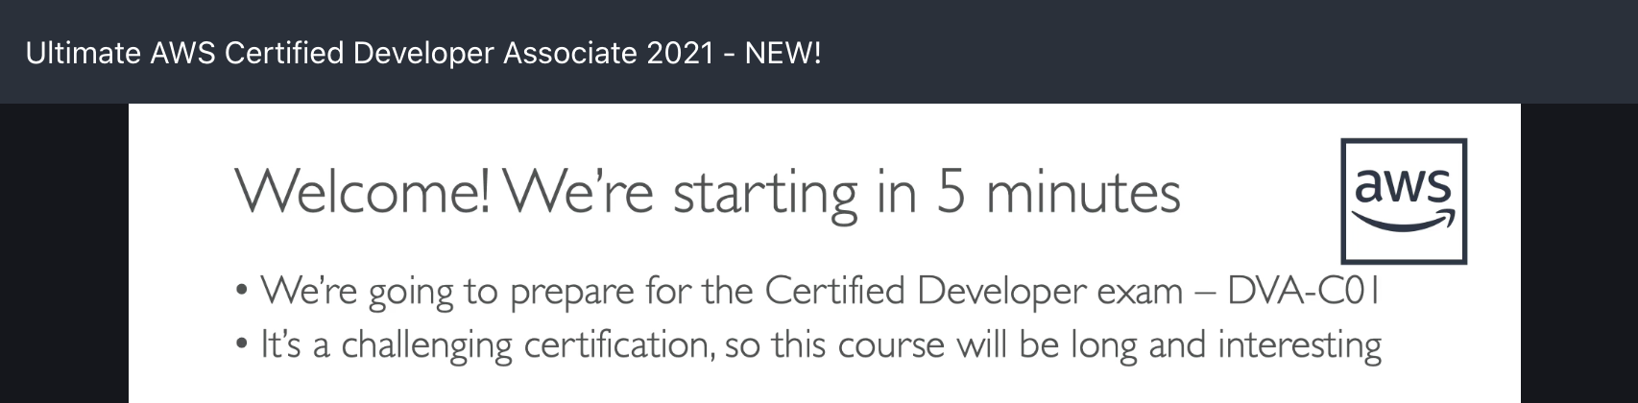
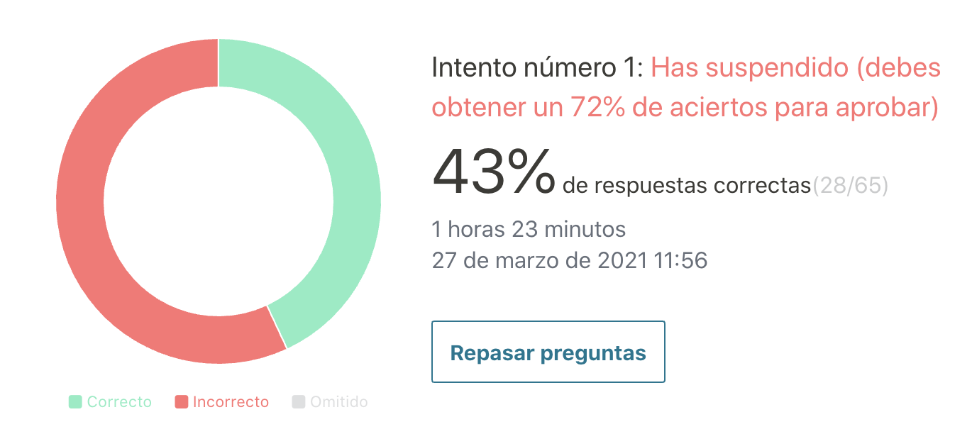
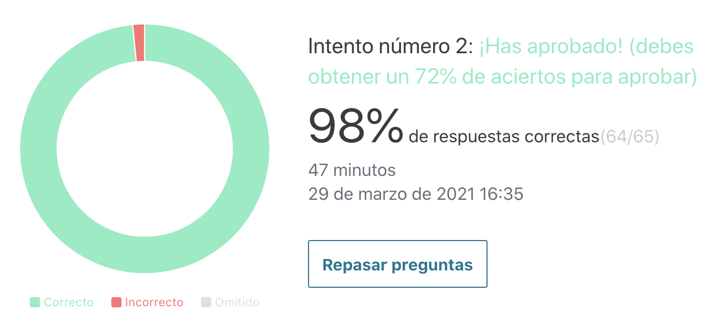
Path to AWS Developer Associate Certification
Courses
https://ibm-learning.udemy.com/course/aws-certified-developer-associate-dva-c01/learn/lecture/11851506?start=30#overview
Practice Exams: Primer intento y Segundo intento
https://ibm-learning.udemy.com/course/aws-developer-associate-practice-exams/learn/quiz/4852744/results?expanded=482142222#overview

Slide 5
Path to AWS Developer Associate Certification
01
Previo al Examen
Re-skilling IBM
Curso Netec
- Terminar Curso Udemy
- Realizar Exámenes hasta obtener 80 a 100%
Solicitar los 30 min extras
System test + install software para rendir
02
Día del Examen
Tener DNI a mano
Habitación cerrada y aislada.
Escritorio limpio.
Conectarse 30 min antes de la hora estipulada para hacer el checkin (fotos + prueba cámara + auditor)

Slide 6
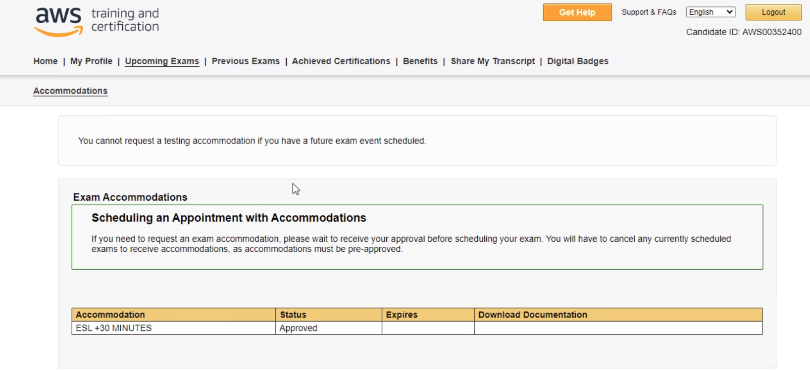
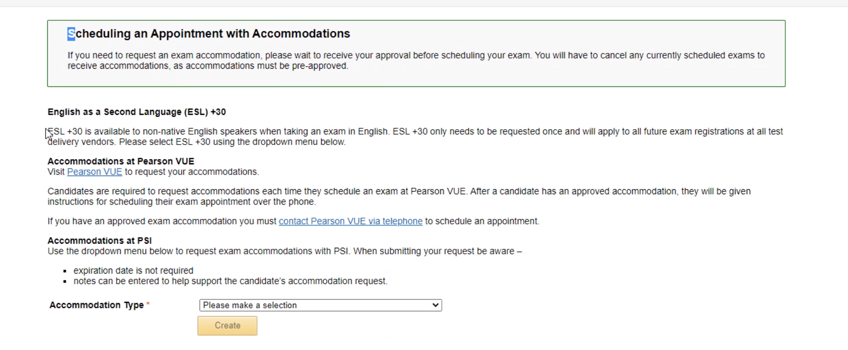
Path to AWS Developer Associate Certification
TIPS
Solicitar los 30 min extras
Aprender nombres de servicios por Abreviación y nombre completo. Ejemplo:
ECS = Elastic Container Service
Darle 15/10 días de estudio a los exámenes.
Crear tu cuenta en AWS y comenzar a probar los aprendido.
Detalle de como solicitar los 30 min extras:
1) https://www.aws.training/
2) https://www.aws.training/Certification
3)https://www.certmetrics.com/amazon/candidate/exam_scheduling.aspx

Slide 7
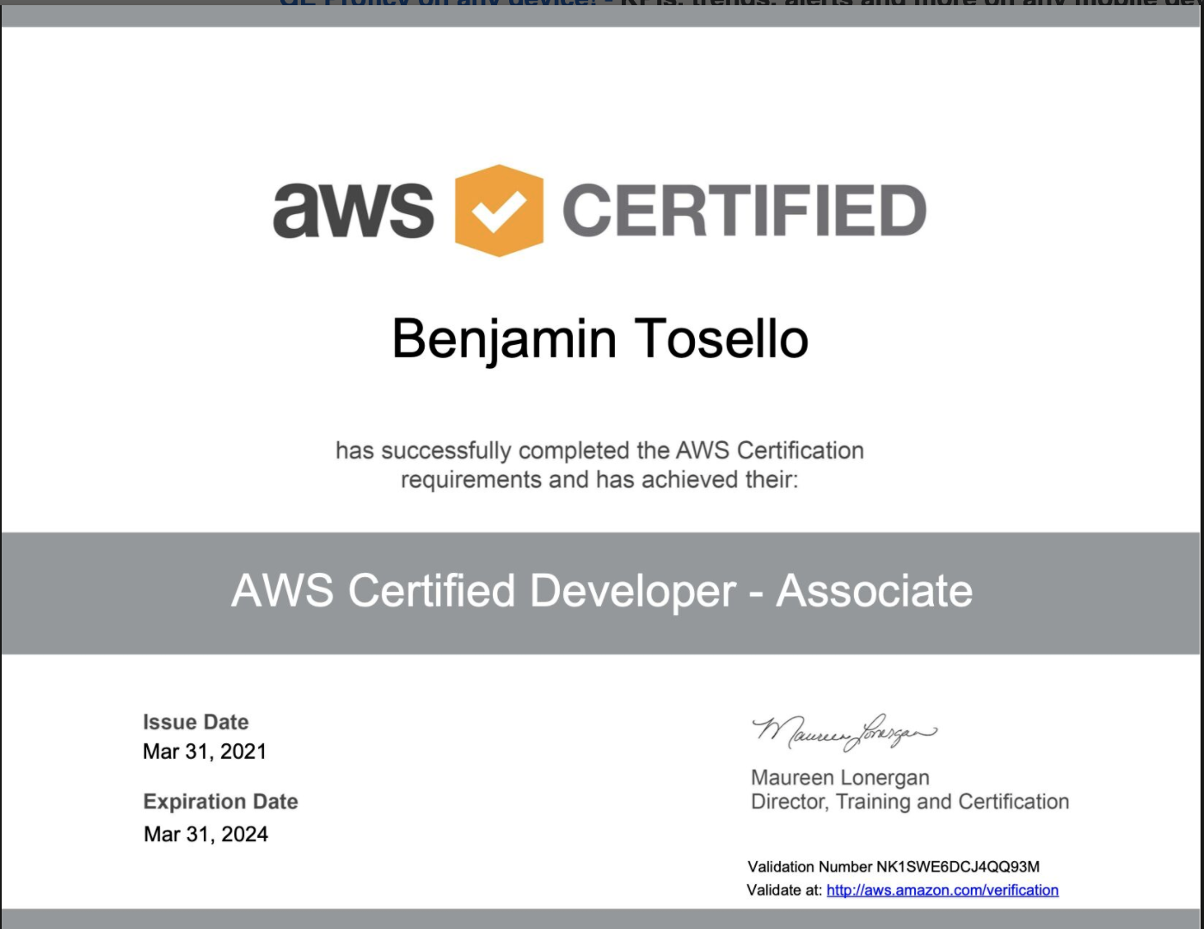
Path to AWS Developer Associate Certification
EXITOS PARA TODOS

Slide 8

Path to AWS Developer Associate Certification
Roadmap & Work
Cheat Sheets
Otros
ALB | Direc Connect | MQ
API Gateway | DynamoDB | OpsWorks
Athena | EBS | Organizatons
Aurora | EC2 | RDS
Auto Scaling | ECS | RedShift
Beanstalk | EFS | Route 53
Cloud Security | ElasticCache | S3
CloudFormation | EMR | SnowBall
CloudFront | FSX | SNS
CloudTrail | Gloabal Accelerator | SQS
CloudWatch | IAM | Storage Gateway
Cognito | Jinesis | SWF
DataSync | KMS | VPC
DB Migration Service | lambda | WAF & Shield
Tutoriales Dojo
Links

